Slide 1
Last Lesson …
We learnt about
The purpose of subroutines
The difference between procedures and functions
How to write procedures and use these in a Python programs

Slide 2
GCSE Computer Science
The Big Question …
What are functions and how are they used in computer programing?
Lesson 13 – Functions
2.2 Programming Fundamentals

Slide 3
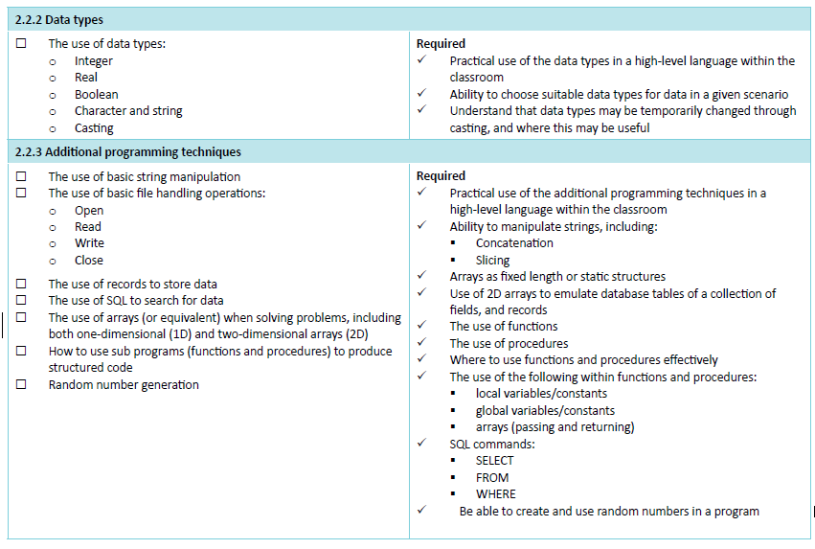
Specification

Slide 4
Lesson objectives
Explain the purpose of functions and parameters
Be able to write functions and use these in a Python programs
Explain the benefits of using functions when writing computer programs

Slide 5
Starter
Functions work just like procedures, except at the end they will return a value
function sum(a, b)
total = a + b
return total
endfunction
answer = sum(5, 3)
print(answer)
What is the output from the above function?
Explain how it works

Slide 6
Answer
Function Definition
function sum(a, b)
total = a + b
return total
endfunction
answer = sum(5, 3)
print(answer)
The output from the function is: 8
First sum(5,3) calls the sum function with the arguments 5 and 3
The sum function adds 5 + 3 and stores 8 in total
The sum function returns the result of 8 to the function call
This is then assigned to the variable called answer
answer (which contains 8) is then output
Calling the function

Slide 7
Passing parameters
When you create a function with the statement:
sum(a, b)
a and b are known as parameters

Slide 8
Return
All functions must contain a return statement
This is used to return a value to the caller (the program that called the function)
Example
function sum(a, b)
total = a + b
return total
endfunction
answer = sum(5, 3)
print(answer)
This function returns the result of adding ‘a’ and ‘b’ together
Here the function is being called with the values ‘5’ and ‘3’. The value returned by the function is assigned to the variable called ‘answer’

Slide 9
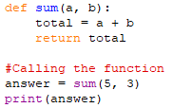
Python Example
Here is how you would write this in Python

Slide 10
Another example
This function takes three parameters (which are numbers) and returns the greatest of the three numbers
function greatest(a, b, c) if a > b AND a > c then return a if b > a AND b > c then return b else return c
end function
Parameters:
a, b, c

Slide 11
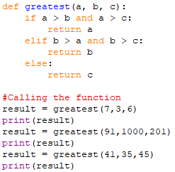
Python Example
Here is how you would write this in Python

Slide 12
Calling a Function
This function calculates the average score by dividing a total score by the number of attempts
function averageScore(totalScore, numScores)
avg = totalScore / numScores
return avg
endfunction
Calling the function:
total = input("Enter total score: ")
n = input("Enter number of scores: ")
average = averageScore(total, n)
print (average)

Slide 13
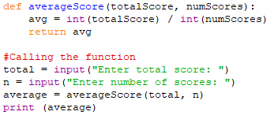
Python Example
Here is how you would write this in Python

Slide 14
Why use subroutines?
They are useful to break up a large program into self-contained units
Each subroutine can be tested separately to make sure it works correctly
Many programmers can work on a large program at the same time, cutting down development time
Subroutines can be re-used in other programs
Subroutines can be stored in a subroutine library and used in different programs if required
Program maintenance is easier – if requirements change then just the affected subroutines need to be modified

Slide 15
Activity 1
Complete the programming exercises on:
functions worksheet #1

Slide 16
Extension Work
Move back on to Little Book of Programming Challenges

Slide 17
Plenary
Can you answer these questions:
What is meant by the terms function and parameters?
What is the purpose of the ‘return’ statement used in functions?
What are the benefits of using functions when writing computer programs?

Slide 18
Homework
Complete the activities above

Slide 19
Further Reading
For further information on this topic, see the following resources:
Computer Science Text book (J277)
Page 120 - 123
Python Programming Manual
Page 50 - 55
Teach-ict
https://teach-ict.com/2016/GCSE_Computing/OCR_J277/2_2_programming/subs/miniweb/index.php

Slide 20
Next Lesson
Local vs Global Variables

